Slide 1
40511: Microsoft Cloud Workshop: Continuous delivery in Azure DevOps

Slide 2
Module overview
Introduction to DevOps
Migrating to Azure DevOps
DevOps Journey
Lab
Project Selection
Module Review and Takeaways
Team Structures

Slide 3
Learning objectives
After completing this module, students will be able to:
Plan for the transformation with shared goals and timelines
Design a license management strategy (e.g. Azure DevOps users)
Select a project and identify project metrics and Key Performance Indicators (KPI’s)
Design a strategy for end-to-end traceability from work items to working software
Create a team and agile organizational structure
Design an authentication and access strategy
Design a strategy for integrating on-premises and cloud resources
Design a tool integration strategy

Slide 4
Transformation planning

Slide 5
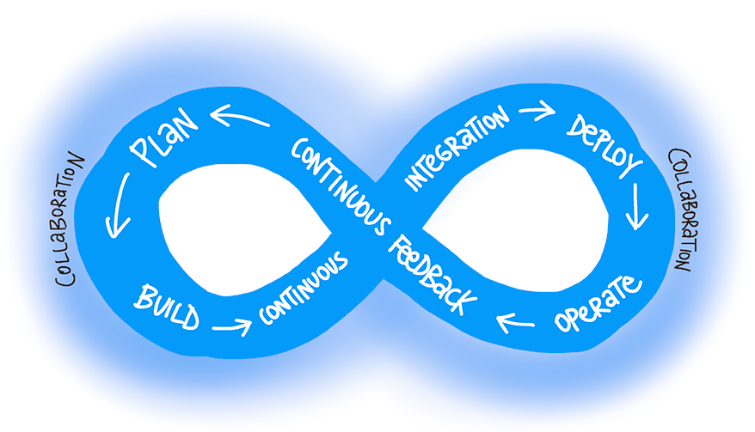
What is DevOps?
"DevOps is the union of people, process, and products to enable continuous delivery of value to end users."
– Donovan Brown, What is DevOps?
Notes:
x

Slide 6
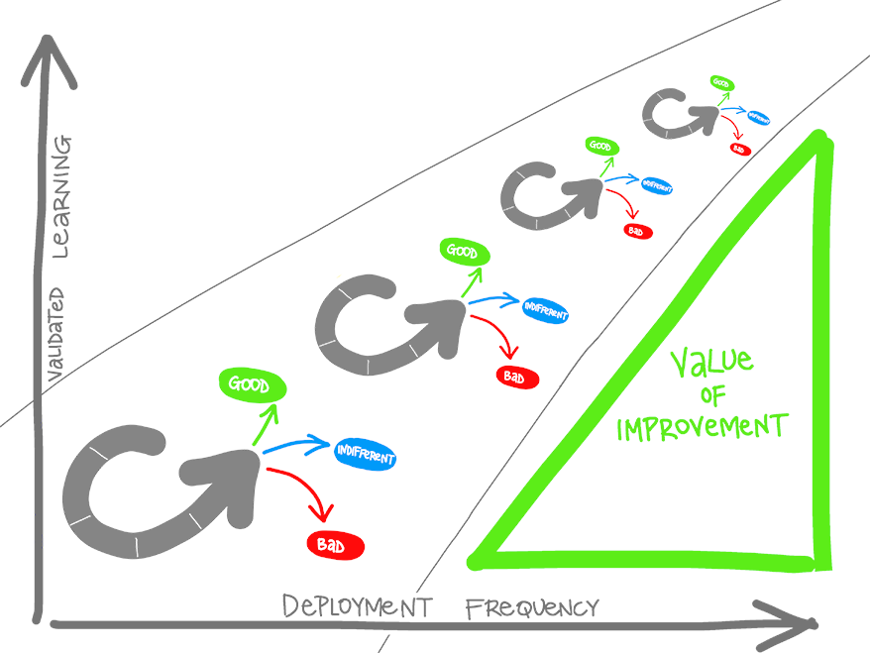
What is DevOps? (continued)
Understand your cycle time
Observe, Orient, Decide, Act (OODA) loop
Become data-informed
Strive for validated learning
Shorten your cycle time
Optimize validated learning
Notes:
x

Slide 7
The DevOps journey
Continuous Integration
Continuous Delivery
Version Control
Agile/lean
Monitoring and logging
Cloud
Infrastructure as Code (IaC)
Microservices
Containers
DevOps may hurt at first
https://docs.microsoft.com/en-us/azure/devops/learn/what-is-devops
Notes:
x

Slide 8

Separating transformation teams
There are several challenges when creating teams:
Availability of staff
Disruption of current procedures and processes
To overcome the challenges, create a team that is:
Focused on the transformation
Well respected in their subject areas
Internal and external to the business
A transformation project can conflict with ongoing business needs

Slide 9
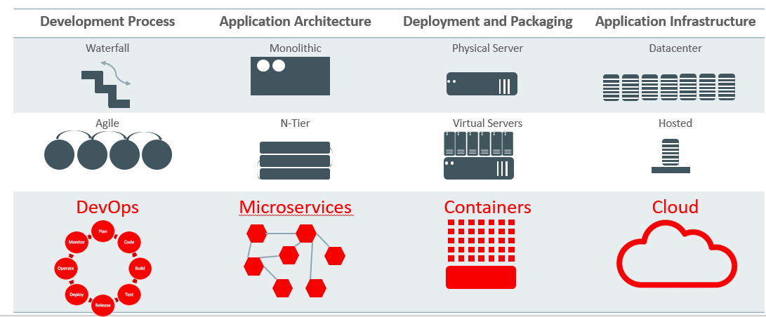
History and Multi-Dimensional Evolution of Computing
Notes:
All of this is part of a transformation of technologies along a number of fronts, and is the basis for modern agile application development.

Slide 10
Defining shared goals
Projects must have a clearly-defined set of measurable outcomes, like:
Reduce the time spent on fixing bugs by 60%
Reduce the time spent on unplanned work by 70%
Reduce the out-of-hours work required by staff to no more than 10% of total working time
Remove all direct patching of production systems
One of the key aims of DevOps is to provide greater customer value, so outcomes should have a customer value focus

Slide 11
Setting timelines for goals
Measurable goals should have timelines that challenging yet achievable
Timelines should be a constant series of short-term goals – each clear and measurable
Shorter timelines have advantages:
Easier to change plans or priorities when necessary
Reduced delay between doing the work and getting feedback
Easier to keep organizational support when positive outcomes are apparent

Slide 12
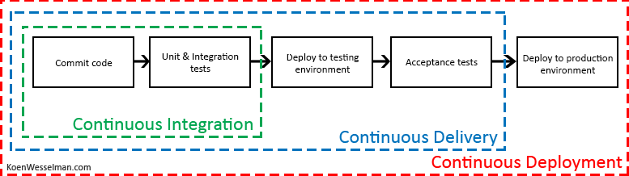
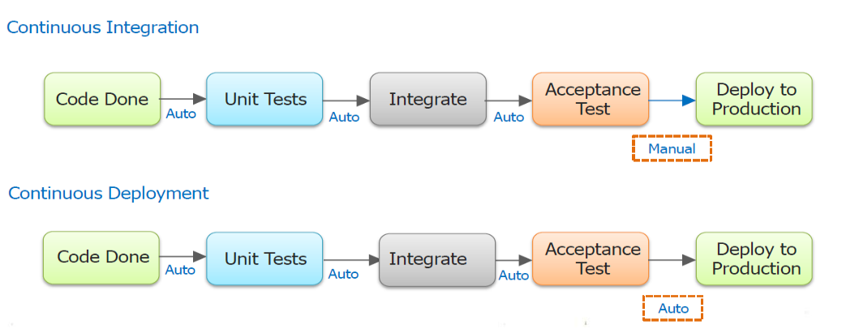
Continuous Integration, Delivery and Deployment

Slide 13
Project selection

Slide 14
Greenfield and brownfield projects defined
Greenfield software projects develop in a totally new environment.
Brownfield software projects develop in the immediate presence of existing software applications/systems.

Slide 15
Choosing greenfield and brownfield projects
Greenfield projects:
Appears to be an easier starting point
A blank slate offers the chance to implement everything the way you want.
Brownfield projects:
Comes with the baggage of existing code bases, existing teams and often a great amount of technical debt
Spending time maintaining existing Brownfield applications, limits the ability to work on new code.
There is a common misconception that DevOps suits greenfield projects better than brownfield projects, but this is not the case.

Slide 16
Choosing systems of record versus systems of engagement
Systems of record:
Emphasize accuracy and security
Provide the truth about data elements
Historically evolve slowly and carefully
Systems of engagement:
Are more exploratory
Use experimentation to solve new problems
Are modified regularly
Prioritize making changes quickly over ensuring that the changes are correct
Both types of systems are important
Notes:
x

Slide 17
Identifying project metrics and Key Performance Indicators (KPIs)
Faster outcomes – Deployment frequency, deployment speed, deployment size, and lead time
Efficiency – Server to admin ratio, staff member to customers ratio, application usage, and application performance
Quality and security – Deployment failure rates, application failure rates, mean time to recover, bug report rates, test pass rates, defect escape rate, availability, service level agreement (SLA) achievement, and mean time to detection
Culture – Employee morale and retention rates
Goals must be specific, measurable, and time-bound

Slide 18
Team structures

Slide 19
Agile development practices defined
Waterfall approach:
Define, analyze, build and test, and deliver
Hard to accurately define requirements, which can change over time, including during development
Requires change requests and additional cost after delivery
Agile approach:
Emphasizes constantly adaptive planning, and early delivery with continual improvement
Development methods are based on releases and iterations
At the end of each iteration, should have tested working code
Is focused on shorter-term outcomes
Notes:
x

Slide 20
Principles of agile development
Measure progress through working software
1
Satisfy the customer through early and continuous delivery of valuable software
7
Agile processes promote sustainable development
2
Welcome changing requirements
8
Continuous attention to technical excellence and good design
3
Deliver working software frequently
9
4
10
Simplicity - the art of maximizing the amount of work not done
Work together throughout the project
5
Build projects around motivated individuals
11
Use self-organizing teams
6
Use face-to-face conversation
12
Reflect on how to become more effective
Source: https://www.agilealliance.org/agile101/12-principles-behind-the-agile-manifesto/
Notes:
12 Principles Behind the Agile Manifesto - https://www.agilealliance.org/agile101/12-principles-behind-the-agile-manifesto/

Slide 21
Creating organizational structures for agile practices
Horizontal team structures divide teams according to the software architecture.
Vertical teams span the architecture and are aligned with product outcomes, and scaling can occur by adding teams.
Vertical teams have been shown to provide stronger outcomes in Agile projects

Slide 22
Ideal DevOps team members
Think there is a need to change and have shown an ability to innovate
Are well-respected and have broad knowledge of the organization and how it operates
Ideally, already believe that DevOps practices are what is needed
Notes:
x

Slide 23
Mentoring team members on agile practices
Many teams hire external agile coaches or mentors
Agile coaches have teaching and mentoring skills
Agile coaches tend to be both trainers and consultants
Some coaches are technical experts
Some coaches are focused on agile processes
Team members must learn as they work, and acquire skills from each other

Slide 24
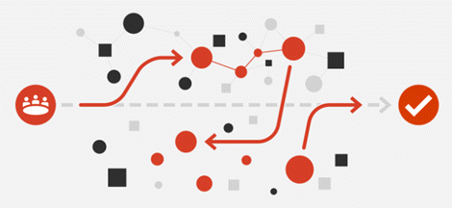
Enabling in-team and cross-team collaboration
Cultural changes – More open workspaces, meeting etiquette, outsourcing, better communication
Cross-functional teams – Collaboration with others, diversity of opinion, rewarding collective behavior
Collaboration tooling –Slack, Teams, Asana, Glip, JIRA

Slide 25
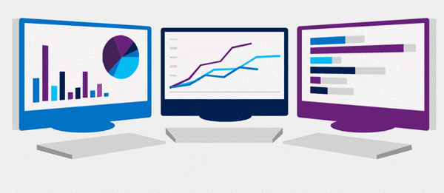
Selecting tools and processes for agile practices
Tools can often enhance the outcomes achieved.
Physical tools such as white boards, index cards, sticky notes
Project Management tools such as Kanban boards for planning, monitoring, and visualization
Screen recording tools for recording bugs, building walk-throughs, and demonstrations
Notes:
x

Slide 26

Migrating to DevOps
Notes:
x

Slide 27
What can Azure DevOps do?
Azure Boards: Agile planning, work item tracking, visualization and reporting tool
Azure Pipelines: A language, platform and cloud agnostic CI/CD platform with support for containers or Kubernetes
Azure Repos: Provides cloud-hosted private git repos
Azure Artifacts: Provides integrated package management with support for Maven, npm, Python and NuGet package feeds from public or private sources
Azure Test Plans: Provides an integrated planned and exploratory testing solution

Slide 28
What can GitHub do?
Codespaces: Provide cloud-hosted collaborative development environments
Repos: Provide cloud-hosted and on-premises git repos for both public and private projects
Actions: Create automation workflows with environment variables and customized scripts
Artifacts: Ease integration with numerous existing packages and open-source repositories
Security: Review code and identity vulnerabilities early in the development cycle
Notes:
x

Slide 29
Designing an authorization and access strategy for Azure DevOps
Azure DevOps Services uses either a Microsoft account or Azure Active Directory, to protect and secure your data
For non-Microsoft tools like Git, NuGet, or Xcode you can use personal access tokens
Azure DevOps is pre-configured with default security groups and permissions
You can also configure app access policies and conditional access policies
Notes:
x

Slide 30

Migrating or integrating existing work management tools
Both Azure DevOps and GitHub can be integrated with a wide variety of existing work management tools:
Trello integration tooling is a free, flexible, and visual way to organize anything with anyone.
Solidify offers a tool for Jira to Azure DevOps migration.
Third party organizations offer commercial tooling to assist with migrating other work management tools like Aha, BugZilla, ClearQuest.
Notes:
x

Slide 31
Migrating or integrating existing test management tools
Azure Test Plans are used to track sprints and milestones. There is a Test & Feedback extension available in the Visual Studio Marketplace.
Other tools:
Apache JMeter is open-source software written in Java and designed to load test functional behavior and measure performance.
Pester is a tool that can be used to automate the testing of PowerShell code.
SoapUI provides another testing framework for SOAP and REST testing.
If you are using Microsoft Test Manager, you should plan to migrate to Azure Test Plans
Notes:
For more information, you can see:
Marketplace search for test management - [(https://marketplace.visualstudio.com/search?term=test%20management&target=AzureDevOps&category=All%20categories&sortBy=Relevance)](https://marketplace.visualstudio.com/search?term=test%20management&target=AzureDevOps&category=All%20categories&sortBy=Relevance)

Slide 32
Designing a license management strategy
Azure DevOps can be licensed for individual services or for users. It offers free and paid tiers:
https://azure.microsoft.com/en-us/pricing/details/devops/azure-devops-services/
GitHub can be licensed for individuals, teams, and enterprises. It offers free and paid tiers:
https://github.com/pricing
Notes:
x

Slide 33
Lab

Slide 34
Lab: Agile planning and portfolio management with Azure Boards
Lab overview:
In this lab you will learn about the agile planning and portfolio management tools and processes provided by Azure Boards and how they can help you quickly plan, manage, and track work across your entire team.
Objectives:
Manage teams, areas, and iterations
Manage work items
Manage sprints and capacity
Customize Kanban boards
Define dashboards
Customize team process
Duration:
Notes:
The labs are updated on a regular basis. For the latest information please visit:
https://microsoftlearning.github.io/AZ400-DesigningandImplementingMicrosoftDevOpsSolutions/

Slide 35
Module review and takeaways

Slide 36
What did you learn?
Plan for the transformation with shared goals and timelines
Design a license management strategy (e.g., Azure DevOps and GitHub users)
Select a project and identify project metrics and Key Performance Indicators (KPI’s)
Design a strategy for end-to-end traceability from work items to working software
Create a team and agile organizational structure
Design an authentication and access strategy
Design a strategy for integrating on-premises and cloud resources
Design a tool integration strategy
Notes:
x

Slide 37
Module review questions
1
Which of the following would a system that manages inventory in a warehouse be considered? - System of Record or System of Engagement
An Agile tool that is used to manage and visualize work by showing tasks moving from left to right across columns representing stages. What is this tool commonly called?
2
3
In which of the following would you find large amounts of technical debt?
Greenfield or Brownfield
4
As a project metric, what is Lead Time measuring?
5
What is a cross-functional team?
Notes:
Q1 Answer: System of Record. Systems that are providing the truth about data elements are often called Systems of Record.
Q2 Answer: Kanban Board. A Kanban Board lets you visualize the flow of work and constrain the amount of work in progress. Your Kanban board turns your backlog into an interactive signboard, providing a visual flow of work.
Q3 Answer: Brownfield Project. A Brownfield Project comes with the baggage of existing code bases, existing teams, and often a great amount of technical debt, they can still be ideal projects for DevOps transformations.
Q4 Answer: Lead time measures the total time elapsed from the creation of work items to their completion.
Q5 Answer: A team that brings people with different functional expertise, and often from different departments, together to work toward a common goal.

